Slide 1
Designing For The Multifaceted User
Designing with users in mind is a tricky thing.
Not only does it require of us a sound understanding of who our users are, but the actual act of translating what we know about them into a well-designed product is not always an obvious or easy path.
Being a human being, acting differently according to circumstance and context is natural.
What does this mean for us as designers? It means that our deliverables right now are probably too prescriptive in their details about who the user is.
We would probably do better to work towards a clearer understanding of the user’s varying contexts — contexts that would yield different behaviors and decisions.
In short, we should focus on the person, not on predicting their reactions and, therefore, what we should effectively be designing for.

Slide 2
Modeling User Groups
The matrix technique explores what we know and what we don’t know about our users by looking through the lens of contexts for their behaviors and motivations.
This method is used to do the following:
to establish key audiences;
to understand or validate value propositions;
to help prioritize research areas and product features — to identify what we already know and where we lack data;
to pinpoint which features are vital.
It is essentially a structured brainstorming tool to make sense of user patterns.
Best of all, it can be an easy way to unpack assumptions that each stakeholder is making about their users.

Slide 3
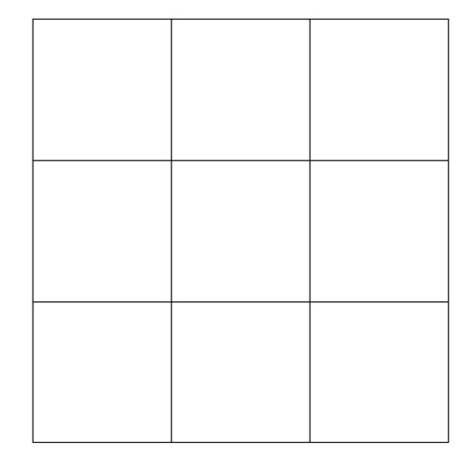
Modeling User Groups
Step 1: Draw Your Matrix - Draw a 3 × 3 grid, this gives enough variation without being too precise.

Slide 4
Modeling User Groups
Step 2: Identify Important Axes - The next step is to identify how many of these different “selves” of our users can exist in this system we are designing for.
Consider an example of a potential social app for runners.
It’s a straightforward offering with which local runners can post routes and visiting runners can find routes. We could imagine virtual competitive elements; a runner might have previously posted a time that you are trying to beat on the same route. Or you might just want a scenic run as a way to explore a new city’s environments.
What kinds of behavioural attributes can we come up with for runners who would likely use this app?
I tend to think in terms of “opposing” attributes. You might end up with a list looking like this and the corresponding user stories:

Slide 5
Modeling User Groups
Step 2: Identify Important Axes (Contd.)
explorative “I want a new way to experience this city through running.”
competitive “I like to race against someone else, or against myself.”
frequent “I run a lot, several times a week to every day.”
occasional “I run once a week or less.”

Slide 6
Modeling User Groups
Step 2: Identify Important Axes (Contd.)
Your axes might then look like this:
curious ↔ engaged
social ↔ individual
explorative ↔ competitive
frequent ↔ occasional
visitor ↔ local

Slide 7
Modeling User Groups
Step 2: Identify Important Axes (Contd.)
Depending on the project you are working on, you may or may not know something about the users you are talking about.
As you go through this exercise, keep in mind what you know about your users and what you are presuming.
From the list above, choose two axes that most interest you or that you think are worth exploring.
Choosing might be difficult if you are just starting with this method; in which case, the best thing to do is to dive in and see what happens.
If it doesn’t work or if ideas don’t seem to flow, change your axes and keep going.

Slide 8
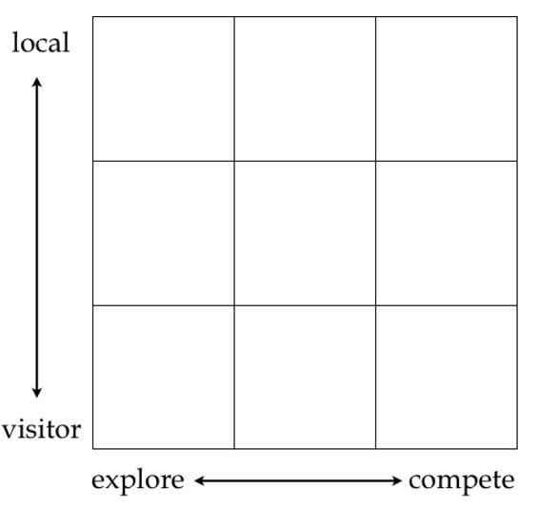
Modeling User Groups
Step 2: Identify Important Axes (Contd.)

Slide 9
Modeling User Groups
Step 3: Identify Key Questions (Contd.)
Ask a question! I generally like, “What would these users want to do?” Or, even more simply, “What do they want?” The latter question would cover what users want to know and what they would want to do.
You could also ask questions like, “How would they feel?” as a kind of emphatic exercise.
As you think up questions, keep a list handy. You’ll need it later.
In this example, let’s stick with “What can they do?” Or, from a user’s perspective, “What can I do with this app?”

Slide 10
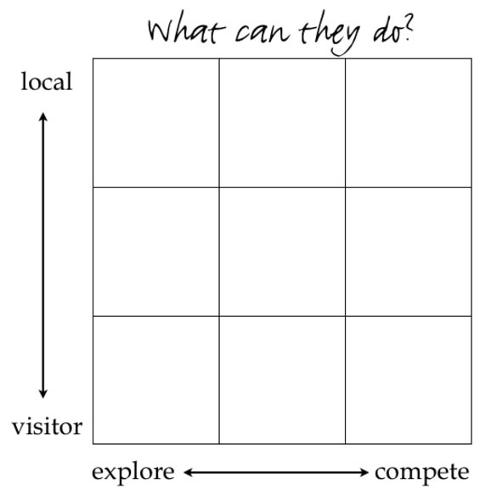
Modeling User Groups
Step 3: Identify Key Questions

Slide 11
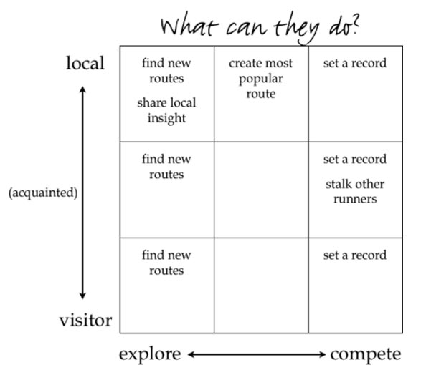
Modeling User Groups
Step 4: Fill the Matrix

Slide 12
Modeling User Groups
Step 4: Fill the Matrix (Contd.)
Fill in the matrix as best you can.
If you already have some insights from research, then mark which things you know for certain, as opposed to things you believe to be true but have nothing yet to back it up.
Generally, by the time you’ve filled the first matrix, you’ll have a fairly good idea of what information you already know about your users and what further research might be required.

Slide 13
Modeling User Groups
Step 5 Iterate:
Once you are done with the first matrix, set that aside, and draw another blank grid.
You can do one of two things:
Pick another question from your list, “What do these users need from us?”; or
Switch one of your axes to something different, but stick to the same question.
Start filling in the matrix again from the top. Remember, this is a brainstorming process. Putting down ideas that you can refine later is more important, so try to move rapidly through each iteration.

Slide 14
Modeling User Groups
Step 5 Iterate (Contd.):
When you have done as much as you can with this iteration of the matrix, do the dance again: pick another question, or switch another axis.
It’s best when your team collectively chooses which questions and spectrums to think about.
Rinse and repeat. You’ll likely find that you can generate a lot of matrices in the space of just an hour, even if it may be a slow start at first.

Slide 15
Modeling User Groups
Step 6 Analysis And Key Insights :
Once you have done a few of these, it is time to sit back and look for patterns. Let’s look at a few things that could emerge.

Slide 16
Modeling User Groups
Step 7 Taking It Further :
we have a set of matrices on our hands and some high-level analysis and insight.
First, as with many workshop tools that encourage structured brainstorming, the process is as important as the result itself, possibly more so.
This process doesn’t generate a pretty formatted deliverable — rather, it clarifies how we really think about our users.

Slide 17
Modeling User Groups
Step 7 Taking It Further (Contd.) :
Having gone through the process of generating these matrices and analyzing them, you should find that you can take on subsequent challenges with more clarity:
Decide which user groups require more research, from which you can generate personas, mental models and user journeys for more detailed tasks, if required.
Establish a product road map based on having identified which needs should be met across user groups, so that you can decide which features to design and build together.

Slide 18
References
https://www.smashingmagazine.com/2013/03/design-multifaceted-user/

